Slide 1
Growth curve analysis
What do those numbers mean?
Matt Winn
(this presentation works best when you view it as a presentation, and not just the slides in editor view)

Slide 2
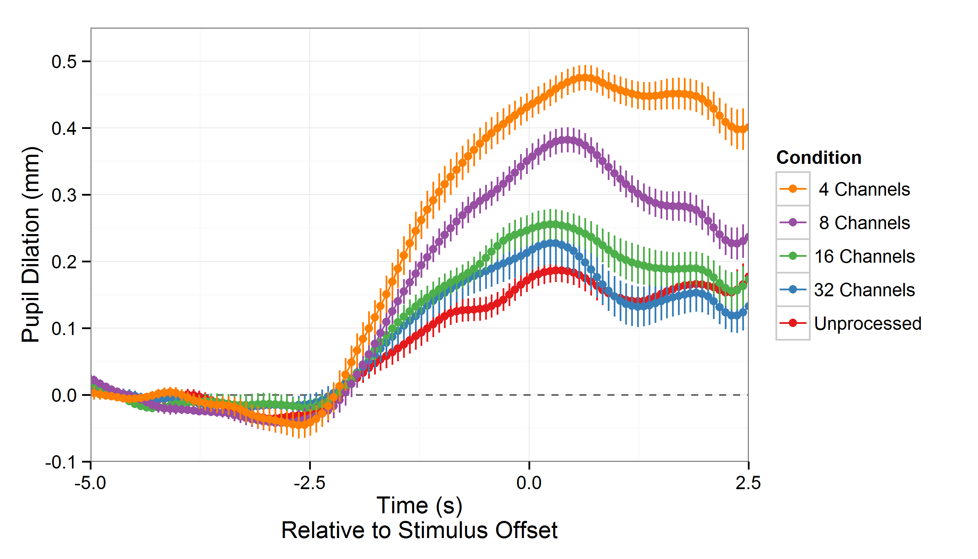
Here are some nice data
This is the
area of growth
Hardest condition
Easiest condition
Don’t worry about the details…

Slide 3
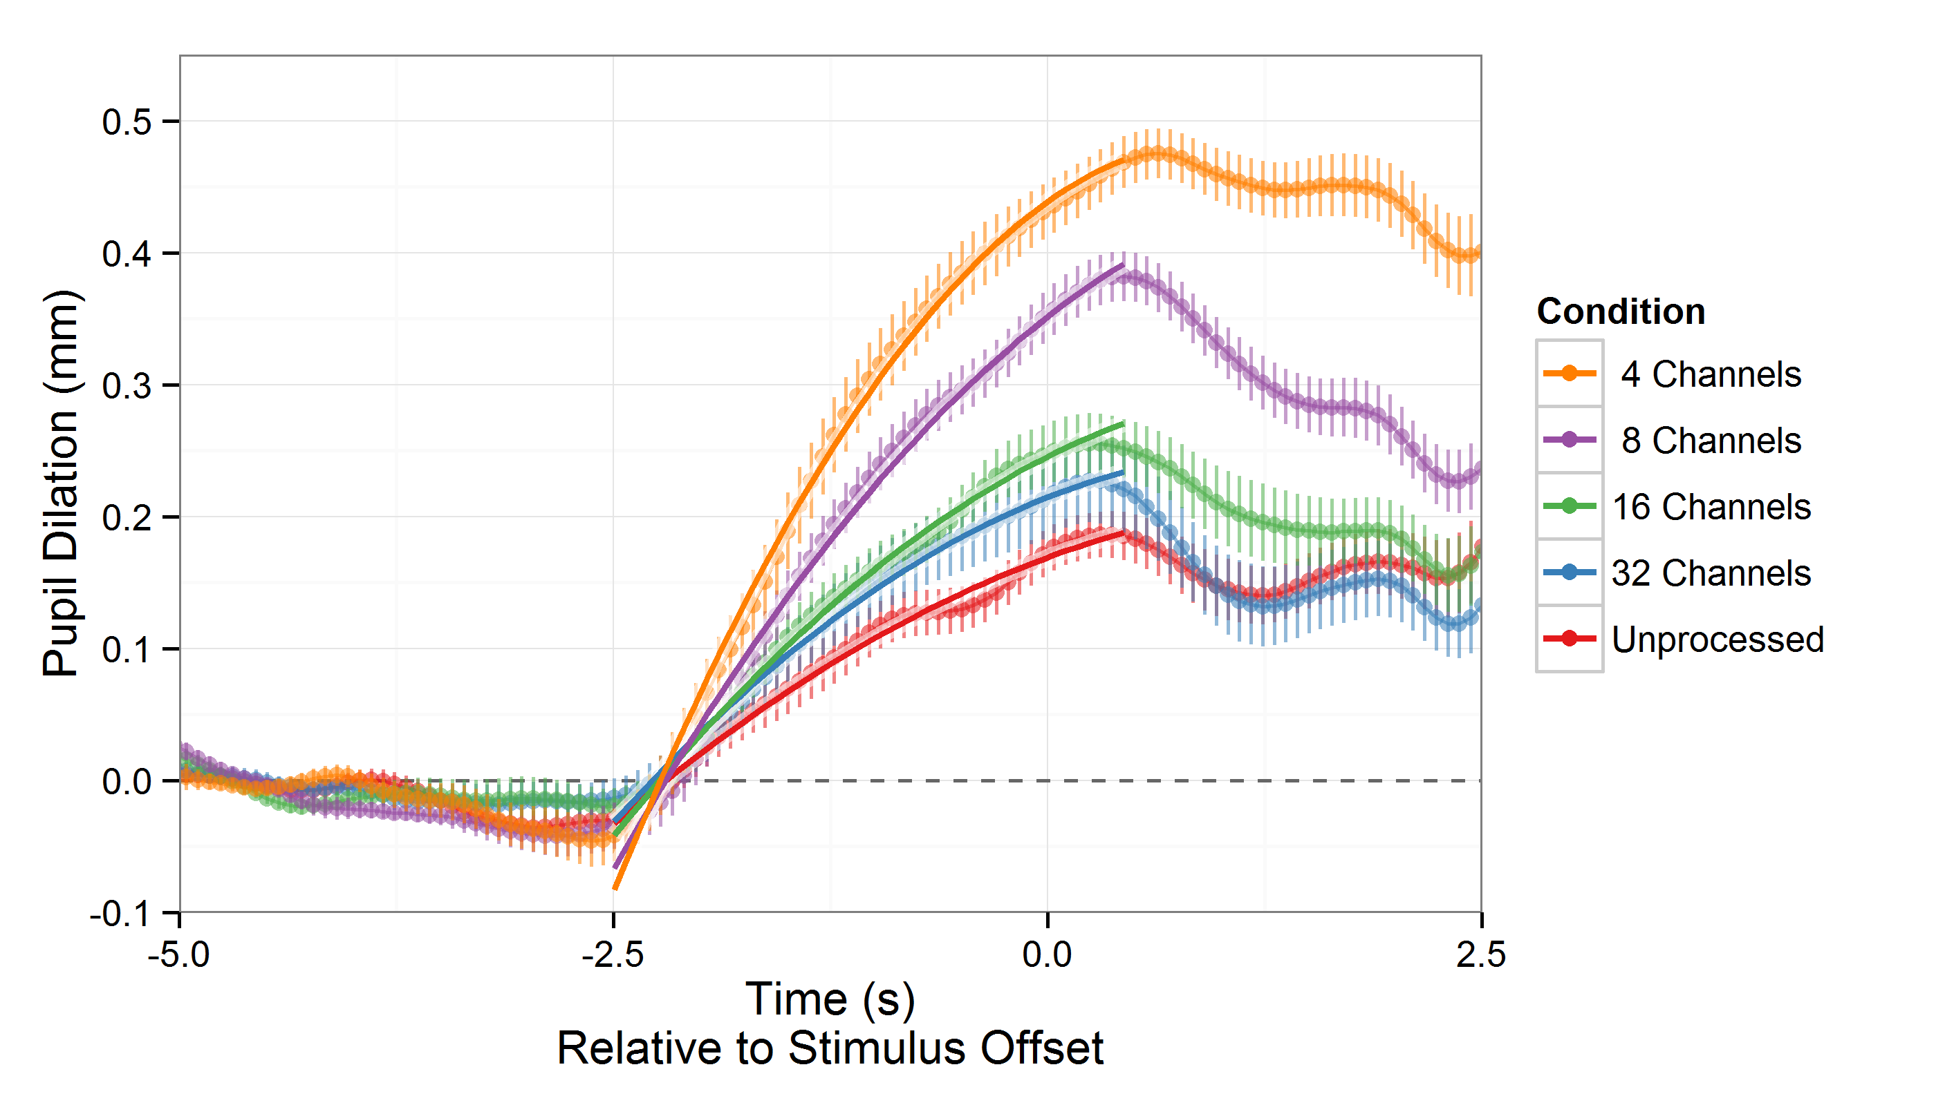
Here are some nice data
With a growth curve model added

Slide 4
Pupil dilation ~ poly(Time, 2) * Condition
Pupil dilation is predicted by time; it changes linearly and quadratically,
and those changes are affected by the experiment condition

Slide 5
Pupil dilation ~ poly1 + poly2 + Condition + poly1:Condition + poly2:Condition
Pupil dilation is predicted by time; it changes linearly and quadratically,
and those changes are affected by the experiment condition
This is simply another way of writing that formula, where we can explicitly keep track of the terms

Slide 6
Pupil dilation ~ poly1 + poly2 + poly1:Condition + poly1:Condition
Term | Estimate
(Intercept) | 0.096
poly1 | 0.436
poly2 | -0.058
Condition32 | 0.032
Condition16 | 0.046
Condition8 | 0.103
Condition4 | 0.163
poly1:Condition32 | 0.088
poly1:Condition16 | 0.182
poly1:Condition8 | 0.471
poly1:Condition4 | 0.660
poly2:Condition32 | -0.027
poly2:Condition16 | -0.030
poly2:Condition8 | -0.058
poly2:Condition4 | -0.150
The model summary gives us all these numbers….
How do we interpret them?

Slide 7
Default condition
(unprocessed) →
Term | Estimate
(Intercept) | 0.096
poly1 | 0.436
poly2 | -0.058
Condition32 | 0.032
Condition16 | 0.046
Condition8 | 0.103
Condition4 | 0.163
poly1:Condition32 | 0.088
poly1:Condition16 | 0.182
poly1:Condition8 | 0.471
poly1:Condition4 | 0.660
poly2:Condition32 | -0.027
poly2:Condition16 | -0.030
poly2:Condition8 | -0.058
poly2:Condition4 | -0.150
There are
Intercept effects
To get the coefficient
for each non-default condition,
Simply add that condition’s Estimate to the Estimate of the default

Slide 8
Term | Estimate
(Intercept) | 0.096
poly1 | 0.436
poly2 | -0.058
Condition32 | 0.032
Condition16 | 0.046
Condition8 | 0.103
Condition4 | 0.163
poly1:Condition32 | 0.088
poly1:Condition16 | 0.182
poly1:Condition8 | 0.471
poly1:Condition4 | 0.660
poly2:Condition32 | -0.027
poly2:Condition16 | -0.030
poly2:Condition8 | -0.058
poly2:Condition4 | -0.150
and
Default condition
(unprocessed) →
Slope effects

Slide 9
Term | Estimate
(Intercept) | 0.096
poly1 | 0.436
poly2 | -0.058
Condition32 | 0.032
Condition16 | 0.046
Condition8 | 0.103
Condition4 | 0.163
poly1:Condition32 | 0.088
poly1:Condition16 | 0.182
poly1:Condition8 | 0.471
poly1:Condition4 | 0.660
poly2:Condition32 | -0.027
poly2:Condition16 | -0.030
poly2:Condition8 | -0.058
poly2:Condition4 | -0.150
and
Default condition
(unprocessed) →
Inflection effects

Slide 10
Term | Estimate
(Intercept) | 0.096
poly1 | 0.436
poly2 | -0.058
Condition32 | 0.032
Condition16 | 0.046
Condition8 | 0.103
Condition4 | 0.163
poly1:Condition32 | 0.088
poly1:Condition16 | 0.182
poly1:Condition8 | 0.471
poly1:Condition4 | 0.660
poly2:Condition32 | -0.027
poly2:Condition16 | -0.030
poly2:Condition8 | -0.058
poly2:Condition4 | -0.150
Default
condition
effects
(unprocessed)
These are the coefficients obtained when we do the default+interaction additions
Intercept effects
Condition | Intercept | Linear | Quadratic
Unproc | 0.096 | 0.436 | -0.058
32 Chan | 0.128 | 0.525 | -0.084
16 Chan | 0.142 | 0.618 | -0.088
8 Chan | 0.199 | 0.907 | -0.116
4 Chan | 0.259 | 1.096 | -0.208
Slope effects
Inflection effects
Now we want to understand what these numbers mean.

Slide 11
Back to the data/model
Those numbers we just saw
represent the intercept, slope, and inflection of these curves
Let’s start by looking at one curve at a time.

Slide 12
Now let’s take a look at the individual components
Components:
Slope
Inflection

Slide 13
Linear component (slope)
Components:
Slope
Inflection

Slide 14
Quadratic component (inflection)
Components:
Slope
Inflection

Slide 15
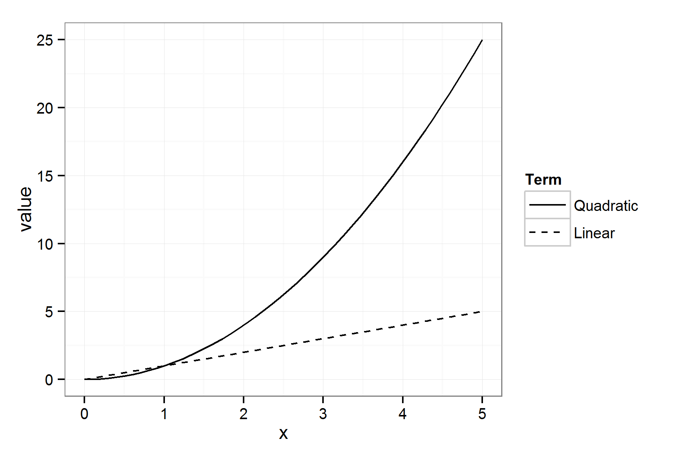
Normally when we think about x and x²…
Does the curve rise because of the linear part?
Or because of the curved part?
Correlated effects are difficult to disentangle ☹
Raw polynomial terms are correlated
data: x and x²
cor = 0.967
r² = 0.94
y = x²
y = x

Slide 16
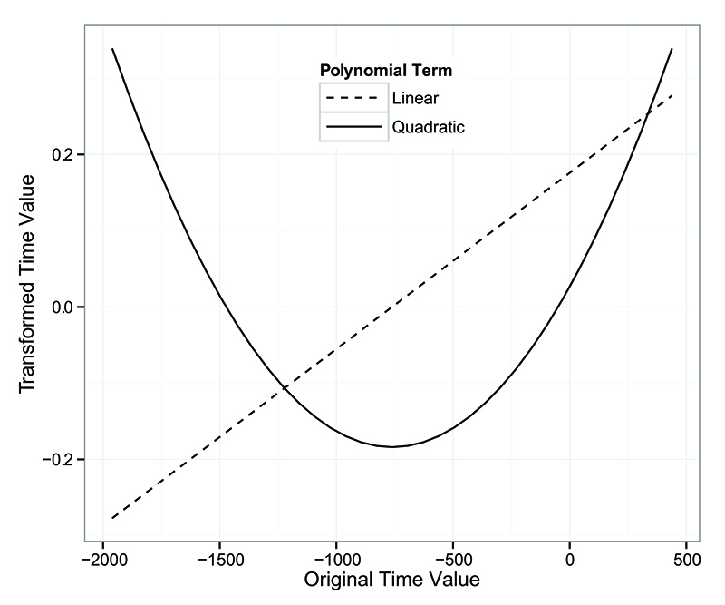
Orthogonal polynomial terms are used to obtain separate effects of slope and inflection
Positive linear coefficient → increased slope

Slide 17
Orthogonal polynomial terms are used to obtain separate effects of slope and inflection
Positive linear coefficient → increased slope
e
e
Negative quadratic coefficient → inverted-U shape

Slide 18
And there’s an overall shift up
(the intercept)
e

Slide 19
Now that we have these components,
let’s see how they contribute to the whole.
e

Slide 20
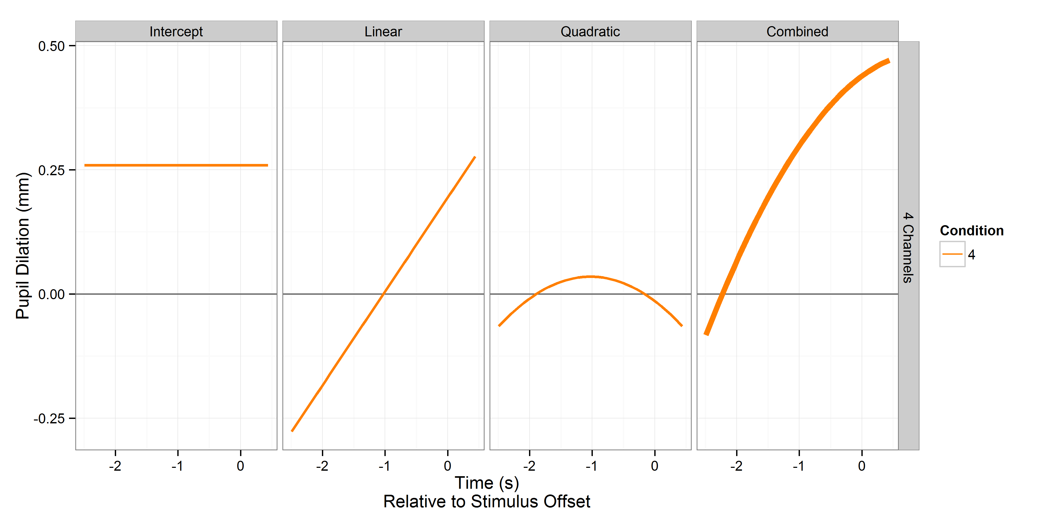
e

Slide 21
Now it’s just linear addition!
(vector)
^
That was just for one condition.
Now that we understand the components,
We can look at all of the conditions in the same way.

Slide 22
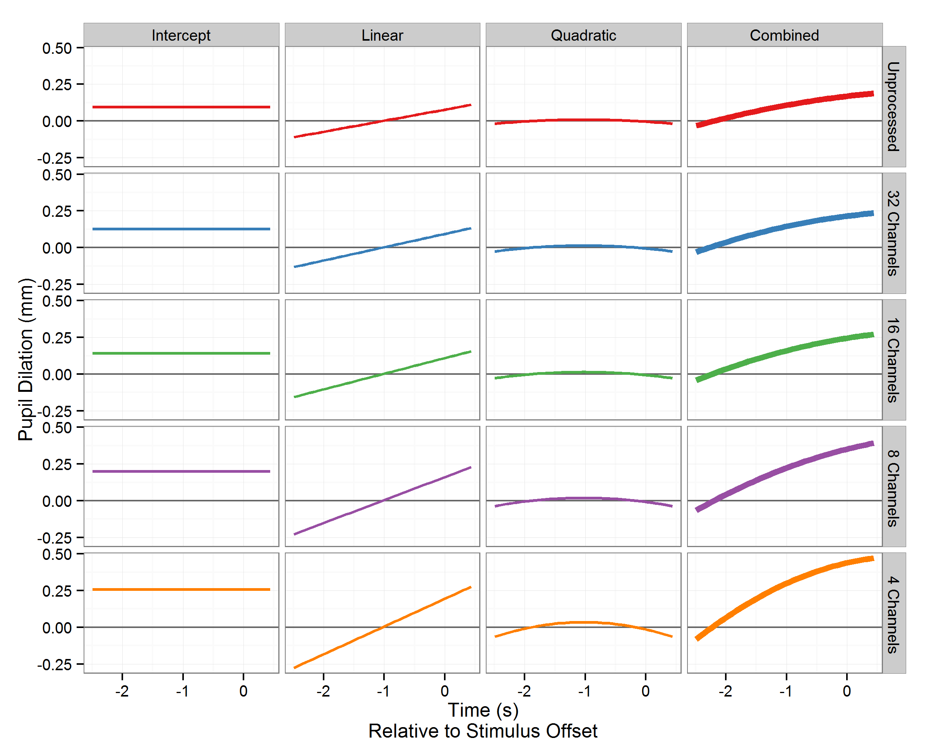
With this view,
it’s easy to compare different polynomial terms…

Slide 23
But it’s difficult to visually compare across conditions.

Slide 24
But it’s difficult to visually compare across conditions.
Because we’re being asked to compare vertically

Slide 25
When we really want to see it this way
Like this

Slide 26
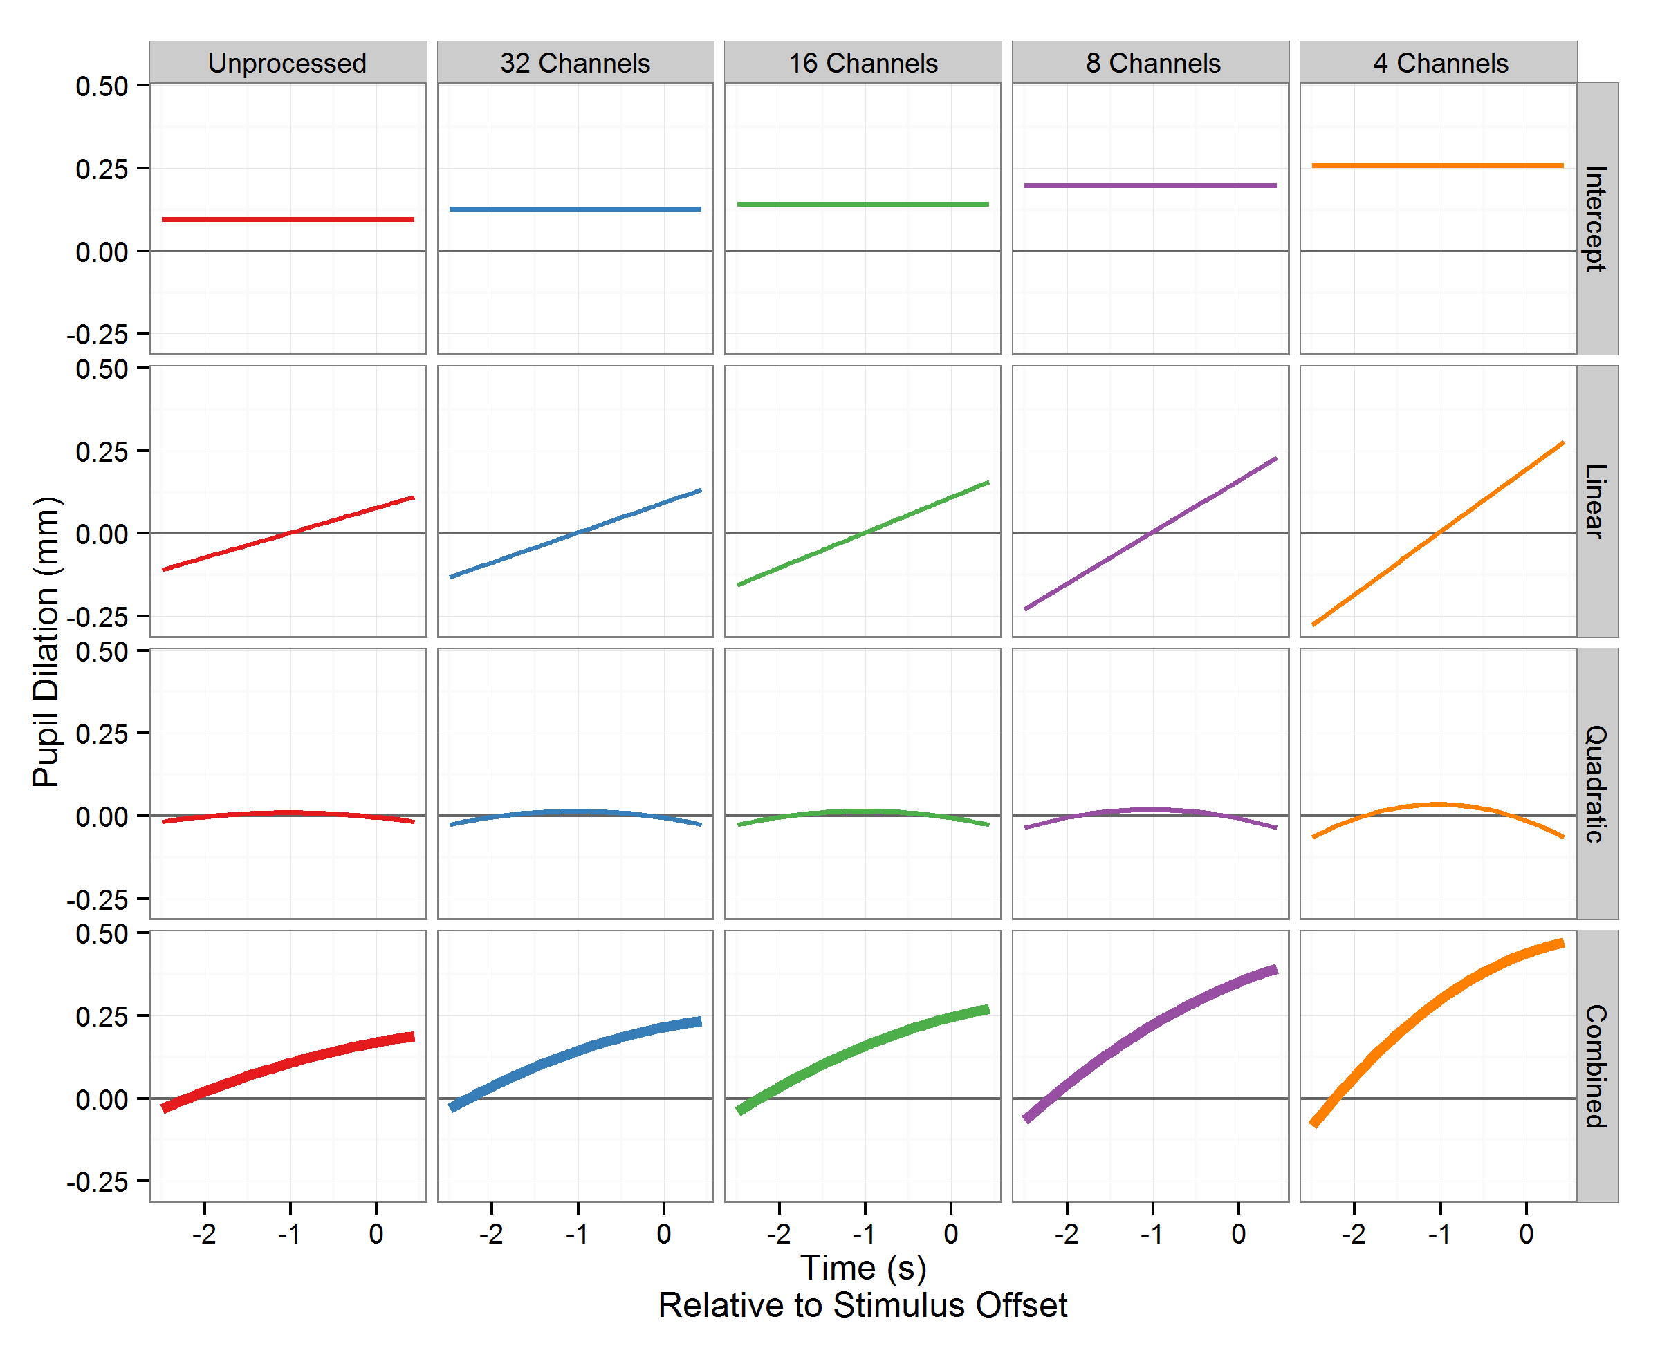
Isn’t that easier?

Slide 27
The intercepts get higher
The slopes
get steeper
The inflections
get … curvier
curvier

Slide 28
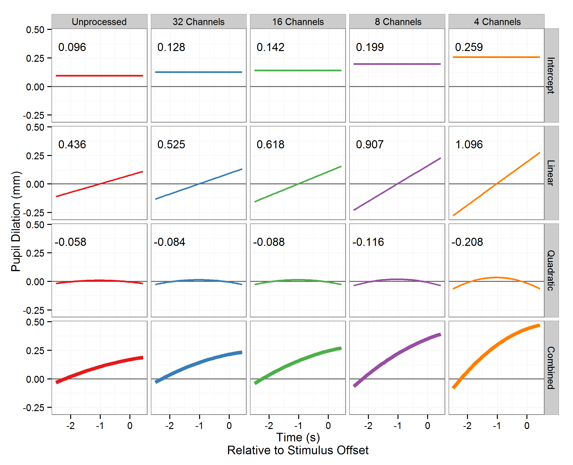
THAT’s
What those numbers mean.

Slide 29
It might be easier to compare them if they are overlapping.

Slide 30
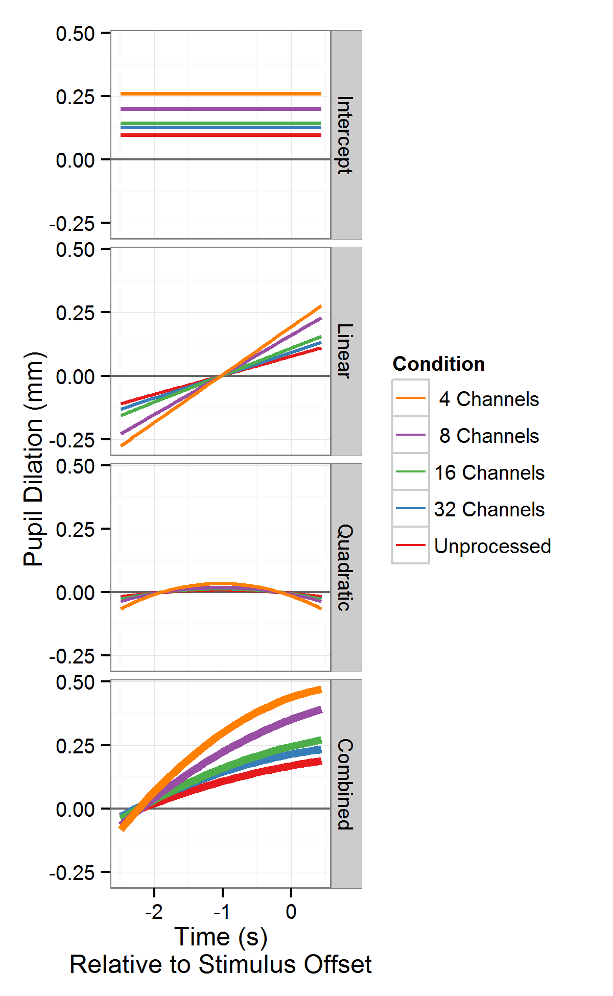
It might be easier to compare them if they are overlapping.
Like this.

Slide 31
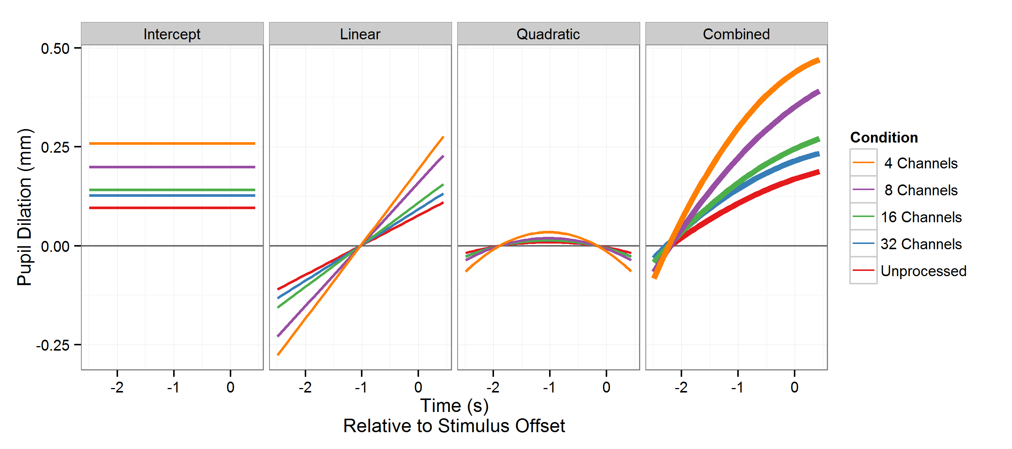
Or, if you’re horizontally inclined…

Slide 32
Or, if you’re horizontally inclined…
Notice how we can now compare slopes
without being distracted
by differences in
overall height

Slide 33
Now we’ve learned the connection between
THIS
and THIS
Term | Estimate
(Intercept) | 0.096
poly1 | 0.436
poly2 | -0.058
Condition32 | 0.032
Condition16 | 0.046
Condition8 | 0.103
Condition4 | 0.163
poly1:Condition32 | 0.088
poly1:Condition16 | 0.182
poly1:Condition8 | 0.471
poly1:Condition4 | 0.660
poly2:Condition32 | -0.027
poly2:Condition16 | -0.030
poly2:Condition8 | -0.058
poly2:Condition4 | -0.150

Slide 34
The End.

